Slide 1
Data Interpretation
L - 1

Slide 2
Data Interpretation(Sub-Topics to be covered)
  Introduction to DI
  Types of DI
  Concepts uses in DI
  Concepts of Ratios
  Concepts of Average
  Concepts of Percentage
  Concepts of Approximation
  Practice Questions on DI

Slide 3
Data Interpretation
What is Data Interpretation?
Data interpretation is the process of reviewing provided data and using these data for calculating the required value. The data can be provided in various forms like in table format, pie chart, line graph, bar graph, or a combination of these.
Types of Data Interpretation
The various types of Data Interpretation are given below:
Tabular DI
Pie Charts
Bar Graph
Line Graph

Slide 4
Data Interpretation
Tabular DI: In Tabular DI, data is provided in horizontal rows and vertical columns called tabular form. A table is one of the simplest and most convenient tools used for summarizing data and presenting it in a meaningful way.
 | Column A Title | Column B Title | Column C Title
Row 1 Title | Data | Data | Data
Row 2 Title | Data | Data | Data
Row 3 Title | Data | Data | Data
Row 4 Title | Data | Data | Data
Row 5 Title | Data | Data | Data
Row 6 Title | Data | Data | Data

Slide 5
Data Interpretation
Pie Charts: It is a circular chart divided into various sectors. The sectors of the circle are constructed in such a way that the area of each sector is proportional to the corresponding values of information provided. In pie charts, the total quantity is distributed over a total angle of 360° or 100%.

Slide 6
Data Interpretation
3. Bar Graph: In Bar Graph, data is represented as horizontal or vertical bars. One of the parameters is given on the x-axis and other on y-axis. Here we need to understand the given information and thereafter answer the given questions. A bar graph or a bar chart presents the grouped data with the help of rectangular bars. These bars are either horizontal or vertical and their lengths are proportional to the value that they represent.

Slide 7
Data Interpretation
Line Graph: A line graph shows the quantitative information or a relationship between
two changing quantities with a line or curve. We are required to understand the given information and thereafter answer the given questions. A line graph or a line chart is a geographical representation of the change in two variables over a period of time. A line graph is created by connecting various data points.

Slide 8
Concepts uses in DI
The majority of the questions asked in the Data Interpretation Section are based on the following topics –
Ratio
Average
Percentage
Approximation
If the basics of these topics are clear, solving DI becomes comparatively easy.

Slide 9
Concepts of Ratio
We can say that the comparison of two quantities of the same kind by division is referred to as ratio. This relation
gives us how many times one quantity is equal to the other quantity. In simple words, the ratio is the number that
can be used to express one quantity as a fraction of the other ones.
The two numbers in a ratio can only be compared when they have the same unit.
Representation of Ratio
The sign used to denote a ratio is ‘:’.
For example A ratio can be written as a fraction, say 5/4, or can be represented by 5 : 4 and read “ 5 is to 4.”
The ratio of any two same quantities p and q can be expressed as either p/q or p : q. Here p is called 'antecedent‘
and q is called 'consequent'.
Ratios are used to compare several quantities like length, height, width, etc. ratios are represented in two forms of
notations.
Odds Notation
Fractional Notation
Odds notation uses ‘:’ i.e. “ is to “ in the expression. For example 2:3.
Ratios in Fractional notation are represented in fraction form. For example ⅔.

Slide 10
Concepts of Average
What is Average?
Average is the mean value which is equal to the ratio of the sum of the
number of a given set of values to the total number of values present in
the set. We apply an average in various areas of real life. So, Average is
defined as the sum of the observations divided by the number of
observations.
Average = Sum of observations / Number of observations

Slide 11
Concepts of Percentage
Percentage means a number or a ratio represented in the form of fractions of 100. It is represented
using the percentage sign ‘%’. In other words, the percentage is defined as how much of one quantity
is made by another quantity and it is evaluated in terms of 100.
Basic Percentage Trick
The following trick can be used to calculate the percentage: X % of y= y % of x
Example: Prove 10% of 50 is equal to 50% of 10
Solution : 10% of 50 = 5
50% of 10 = 5
Hence, they are equal i.e. x % of y = y % of x holds salary original fractions.

Slide 12
Percentage Formula
We should know the percentage formulas to calculate the percentages. The basic formula used to
calculate the percentage is equal to the ratio of actual value to the total value and multiply it by 100.
The formula of the percentages expressed as
Percentage % = (Actual value)/Total value∗100
Percentage Formula in Case of a Fraction
(Numerator/Denominator)∗100
Percentage Change Formula
Percentage change=(New value - Original value)/Original value∗100

Slide 13
Percentage Increases Formula
When the new value is greater than the original value. The percentage change in the value signifies the
percentage increase in the original number such that,
Percentage Increase (% Increase) = Increase in value/original value×100
Here, Increase in value = New value – original value.
Percentage Decreases Formula
When the new value is lesser than the original value. The percentage change in the value signifies the
Percentage decrease in the original number such that,
Percentage Decrease (% Decrease) =Decrease in value/original value×100
Here, Decrease in value = Original value - New value

Slide 14
How to Convert Fraction to Percent?
To convert fraction to a percent, you just need to multiply the fraction by 100 and reduce it to percent.
Example 1: Convert 3/4 to a percent.
Solution:
Step 1: Convert the fraction 3/4 into decimal
Step 2: 3/4 = 0.75
Step 3: Multiply the decimal by 100: 0.75 × 100 = 75%
Therefore, the solution is 75%.

Slide 15
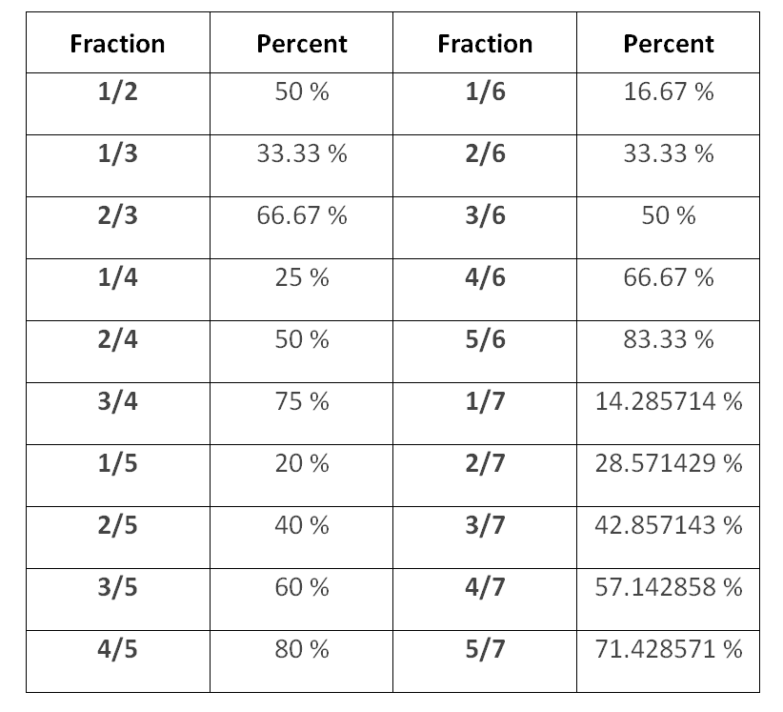

Slide 16
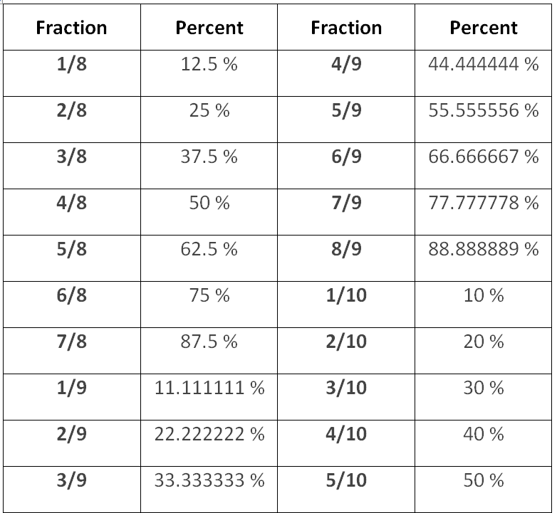

Slide 17
Concepts of Approximation
Approximation is an important theory in Mathematics that is employed when it's difficult to seek out
the precise value of any number.
The term ‘Approximation’ is derived from Latin word ‘Proximus’ meaning ‘very near’ or ‘nearest’.
It is the nearest estimate or measure of something.
It is also used in order to round off the errors leading to approximation.
Approximation is used in various disciplines such as mathematics, science, and day-to-day life.
Approximations Symbol
Approximation is defined as something which is similar to but not the same as something
else. Approximations are generally denoted by the wavy equal “≈” sign which means “almost equal to”.
Example: The approximate value of √2 is 1.414.
Thus, it can be written as √2 ≈ 1.414.

Slide 18
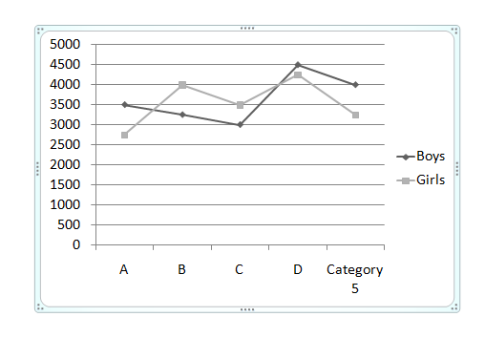
Data Interpretation
Directions: On the basis of the figure below answer the following question. In the graph, the number of boys and girls are given in five schools. Study this graph properly and answer the questions.

Slide 19
Data Interpretation
What approx. percentage will be the number of girls in school A out of the total number of girls in all the schools?
A) 15
B) 17
C) 22
D) 24
Notes:
Difficulty Level: Easy
Correct option: A
the total number of girls is 17750 and the girls in school A as a part of all the girls in all the schools will be (2750/17750) x 100 = 15.4%

Slide 20
Data Interpretation
Which class has the highest percentage of boys and girls with respect to the total students in all the schools?
A) A
B) B
C) C
D) D
Notes:
Difficulty Level: Easy
Correct option: D
From the figure you can see the highest of boys and girls in one school is in D.
As the base for all the schools remains a same i.e. total number of students all the schools will be same for every school then we can say that in school the percentage of students is the highest

Slide 21
Data Interpretation
Which school has the lowest number of students?
A) A
B) B
C) C
D) D
Notes:
Difficulty Level: Easy
Correct option: A
In school A the number of students is the lowest.

Slide 22
Data Interpretation
What is the percentage of girls in school B w.r.t boys of school D?
A) 88.89%
B) 78.89%
C) 66.67%
D) 82.22%
Notes:
Difficulty Level: Easy
Correct option: A

Slide 23
Data Interpretation
What is the ratio of 40% boys of school A to 30% girl of school C?
A) 4: 3
B) 2: 3
C) 3: 4
D) 4: 5
Notes:
Difficulty Level: EASY
Correct option: A
In school A the number of students is the lowest.

Slide 24
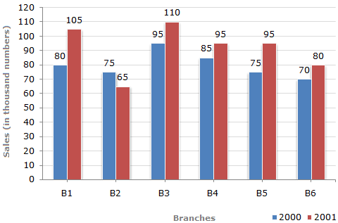
Data Interpretation
Directions to Solve: The bar graph given below shows the sales of books (in thousand number) from six branches of a publishing company during two consecutive years 2000 and 2001.
Sales of Books (in thousand numbers) from Six Branches - B1, B2, B3, B4, B5 and B6 of a publishing Company in 2000 and 2001.
Notes:
Difficulty Level: EASY
Correct option: A
In school A the number of students is the lowest.

Slide 25
Data Interpretation
What is the ratio of the total sales of branch B2 for both years to the total sales of branch B4 for both years?
2:3
3:5
4:5
7:9
Notes:
Difficulty Level: EASY
Correct option: D
Explanation:
Required ratio =(75 + 65)/(85 + 95)=140/180=7/9

Slide 26
Data Interpretation
Total sales of branch B6 for both the years is what percent of the total sales of branches B3 for both the years?
68.54%
71.11%
73.17%
75.55%
Notes:
Difficulty Level: EASY
Correct option: C
Required percentage=(70 + 80)/ (95 + 110) x 100%=150/205 x 100%= 73.17%.

Slide 27
Data Interpretation
What percent of the average sales of branches B1, B2 and B3 in 2001 is the average sales of branches B1, B3 and B6 in 2000?
75%
77.5%
82.5%
87.5%
Notes:
Difficulty Level: EASY
Correct option: D
Average sales (in thousand number) of branches B1, B3 and B6 in 2000
=1/3x (80 + 95 + 70)=245/3
Average sales (in thousand number) of branches B1, B2 and B3 in 2001
=1/3x (105 + 65 + 110)=280/3
Required percentage =(245/3)/(280/3) x 100% =245/280 x 100% = 87.5%

Slide 28
Data Interpretation
What is the average sales of all the branches (in thousand numbers) for the year 2000?
73
80
83
88
Notes:
Difficulty Level: EASY
Correct option: B
Explanation:
Average sales of all the six branches (in thousand numbers) for the year 2000
=1/6x [80 + 75 + 95 + 85 + 75 + 70]
= 80.

Slide 29
Data Interpretation
Total sales of branches B1, B3 and B5 together for both the years (in thousand numbers) is?
250
310
435
560
Notes:
Difficulty Level: EASY
Correct option: D
Explanation:
Total sales of branches B1, B3 and B5 for both the years (in thousand numbers)
= (80 + 105) + (95 + 110) + (75 + 95)
= 560.

Slide 30
Directions: The table below shows the number of the laptops that were sold by the showrooms in the years from 2006 to 2010. Answer the below questions based on the information given in the table.
Data Interpretation
Years/ Showroom | A | B | C | D | E | F
2006 | 183 | 123 | 277 | 167 | 178 | 237
2007 | 178 | 272 | 269 | 95 | 379 | 198
2008 | 133 | 161 | 226 | 176 | 239 | 277
2009 | 264 | 107 | 237 | 225 | 282 | 237
2010 | 278 | 272 | 213 | 284 | 293 | 196

Slide 31
What will be an average number of laptops sold by showroom D in given period?
A) 192.4
B) 189.4
C) 204.4
D) 213.4
Data Interpretation
Years/ Showroom | A | B | C | D | E | F
2006 | 183 | 123 | 277 | 167 | 178 | 237
2007 | 178 | 272 | 269 | 95 | 379 | 198
2008 | 133 | 161 | 226 | 176 | 239 | 277
2009 | 264 | 107 | 237 | 225 | 282 | 237
2010 | 278 | 272 | 213 | 284 | 293 | 196
Notes:
Difficulty Level: Easy( OPTIONAL)
Correct option: B

Slide 32
What will be an average number of laptops sold by all the showrooms in the year 2007?
A) 231
B) 222
C) 208
D) 213
Data Interpretation
Years/ Showroom | A | B | C | D | E | F
2006 | 183 | 123 | 277 | 167 | 178 | 237
2007 | 178 | 272 | 269 | 95 | 379 | 198
2008 | 133 | 161 | 226 | 176 | 239 | 277
2009 | 264 | 107 | 237 | 225 | 282 | 237
2010 | 278 | 272 | 213 | 284 | 293 | 196
Notes:
Difficulty Level: EASY( OPTIONAL)
Correct option: A
We know the formula for the average which is total laptop sold in 2007/number of stores.
Here total number of laptops = (178 + 272 + 269 + 95 + 379 + 198) = 1294
Number of laptop showrooms are 6.
So, 1391/6 = 231.33.
So the correct answer is 231.

Slide 33
By how much percentages the laptops sold by the showroom E in 2008 were less than the showroom A in 2010?
A) 10
B) 12
C) 14
D) 16
Data Interpretation
Years/ Showroom | A | B | C | D | E | F
2006 | 183 | 123 | 277 | 167 | 178 | 237
2007 | 178 | 272 | 269 | 95 | 379 | 198
2008 | 133 | 161 | 226 | 176 | 239 | 277
2009 | 264 | 107 | 237 | 225 | 282 | 237
2010 | 278 | 272 | 213 | 284 | 293 | 196
Notes:
Difficulty Level: Moderate ( COMPULSORY)
Correct option: C
The total number of laptops there were sold by E in 2008 = 239.
The total number of laptops be ((278 – 239)/278) * 100 = 14.02 %
As the values in the question are rounded off to nearest integer the correct answer 14%.

Slide 34
Laptops sold by showroom A in 2010 is how much more percent than the laptops sold by showroom F in 2007?
A) 40.40%
B) 50.50%
C) 60.60%
D) 70.70%
Data Interpretation
Years/ Showroom | A | B | C | D | E | F
2006 | 183 | 123 | 277 | 167 | 178 | 237
2007 | 178 | 272 | 269 | 95 | 379 | 198
2008 | 133 | 161 | 226 | 176 | 239 | 277
2009 | 264 | 107 | 237 | 225 | 282 | 237
2010 | 278 | 272 | 213 | 284 | 293 | 196
Notes:
Difficulty Level: Moderate (COMPULSORY)
Correct option: A

Slide 35
What will be the ratio of total laptops sold by B and C in 2007 to laptops sold by D and E in 2010?
A) 541: 577
B) 466: 571
C) 641: 677
D) 213: 331
Data Interpretation
Years/ Showroom | A | B | C | D | E | F
2006 | 183 | 123 | 277 | 167 | 178 | 237
2007 | 178 | 272 | 269 | 95 | 379 | 198
2008 | 133 | 161 | 226 | 176 | 239 | 277
2009 | 264 | 107 | 237 | 225 | 282 | 237
2010 | 278 | 272 | 213 | 284 | 293 | 196
Notes:
Difficulty Level: Moderate ( OPTIONAL)
Correct option: A

Slide 36
Direction: Study the following table and answer the questions based on it:
Expenditures of a Company (in Lakh Rupees) per Annum Over the given Years
Data Interpretation
Year | Item of Expenditure
 | Salary | Fuel and Transport | Bonus | Interest on Loans | Taxes
1998 | 288 | 98 | 3.00 | 23.4 | 83
1999 | 342 | 112 | 2.52 | 32.5 | 108
2000 | 324 | 101 | 3.84 | 41.6 | 74
2001 | 336 | 133 | 3.68 | 36.4 | 88
2002 | 420 | 142 | 3.96 | 49.4 | 98
What is the average amount of interest per year which the company had to pay during the period 1998 to 2001?
A) Rs. 32.435 lakhs
B) Rs. 33.475 lakhs
C) Rs. 34.185 lakhs
D) Rs. 36.666 lakhs
Notes:
Difficulty Level: Moderate (COMPULSORY)
Option: B

Slide 37
Direction: Study the following table and answer the questions based on it:
Expenditures of a Company (in Lakh Rupees) per Annum Over the given Years
Data Interpretation
Year | Item of Expenditure
 | Salary | Fuel and Transport | Bonus | Interest on Loans | Taxes
1998 | 288 | 98 | 3.00 | 23.4 | 83
1999 | 342 | 112 | 2.52 | 32.5 | 108
2000 | 324 | 101 | 3.84 | 41.6 | 74
2001 | 336 | 133 | 3.68 | 36.4 | 88
2002 | 420 | 142 | 3.96 | 49.4 | 98
The total amount of bonus paid by the company during the given period is approximately what percent of the total amount paid on fuel & transport during this period?
A) 1%
B) 1.5%
C) 2%
D) 3%
Notes:
Difficulty Level: Moderate (COMPULSORY)
Option: D

Slide 38
Direction: Study the following table and answer the questions based on it:
Expenditures of a Company (in Lakh Rupees) per Annum Over the given Years
Data Interpretation
Year | Item of Expenditure
 | Salary | Fuel and Transport | Bonus | Interest on Loans | Taxes
1998 | 288 | 98 | 3.00 | 23.4 | 83
1999 | 342 | 112 | 2.52 | 32.5 | 108
2000 | 324 | 101 | 3.84 | 41.6 | 74
2001 | 336 | 133 | 3.68 | 36.4 | 88
2002 | 420 | 142 | 3.96 | 49.4 | 98
Total expenditure on all these items in 1999 was approximately what percent of the total expenditure in 2002?
A) 83%
B) 80%
C) 85%
D) 79%
Notes:
Difficulty Level: Moderate (COMPULSORY)
Option: A

Slide 39
Direction: Study the following table and answer the questions based on it:
Expenditures of a Company (in Lakh Rupees) per Annum Over the given Years
Data Interpretation
Year | Item of Expenditure
 | Salary | Fuel and Transport | Bonus | Interest on Loans | Taxes
1998 | 288 | 98 | 3.00 | 23.4 | 83
1999 | 342 | 112 | 2.52 | 32.5 | 108
2000 | 324 | 101 | 3.84 | 41.6 | 74
2001 | 336 | 133 | 3.68 | 36.4 | 88
2002 | 420 | 142 | 3.96 | 49.4 | 98
The total expenditure of the company over these items during the year 2001 is?
A) Rs. 544.44 lakhs
B) Rs. 597.08 lakhs
C) Rs. 446.46 lakhs
D) Rs. 478.87 lakhs
Notes:
Difficulty Level: Moderate COMPULSORY)
Option: B

Slide 40
Direction: Study the following table and answer the questions based on it:
Expenditures of a Company (in Lakh Rupees) per Annum Over the given Years
Data Interpretation
Year | Item of Expenditure
 | Salary | Fuel and Transport | Bonus | Interest on Loans | Taxes
1998 | 288 | 98 | 3.00 | 23.4 | 83
1999 | 342 | 112 | 2.52 | 32.5 | 108
2000 | 324 | 101 | 3.84 | 41.6 | 74
2001 | 336 | 133 | 3.68 | 36.4 | 88
2002 | 420 | 142 | 3.96 | 49.4 | 98
The ratio between the total expenditure on Taxes for all the years and the total expenditure on Fuel and Transport for all the years respectively is approximately?
A) 4:7
B) 10:13
C) 15:18
D) 5:8
Notes:
Difficulty Level: Moderate (COMPULSORY)
Option: B

Slide 41
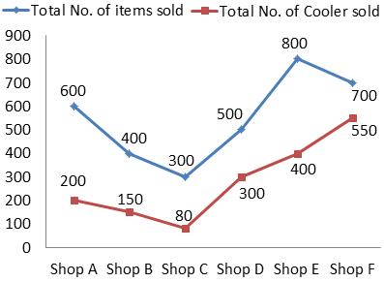
Directions: Study the following line and table chart carefully and answer the questions given below:
Data Interpretation
The following line graph shows the total number of items sold by different shops from January to June 2019.
The following table shows the ratio of defective Cooler sold to the defective AC sold
Shops | Cooler : AC
Shop A | 2 : 1
Shop B | 5 : 6
Shop C | 1 : 2
Shop D | 4 : 1
Shop E | 1 : 1
Shop F | 3 : 1
Note: The total number of items = Cooler + AC + Others

Slide 42
In shop A, the ratio of total number of AC sold to that of the total number of Others items sold is 1 : 3 and the total number of non-defective AC sold by shop A is 40, then find the total number of defective Coolers sold by shop A?
A) 50
B) 120
C) 130
D) 140
Data Interpretation
Shops | Cooler : AC
Shop A | 2 : 1
Shop B | 5 : 6
Shop C | 1 : 2
Shop D | 4 : 1
Shop E | 1 : 1
Shop F | 3 : 1
Note: The total number of items = Cooler + AC + Others
Notes:
Difficulty Level: Expert (COMPULSORY)
Correct option: B
600=200+x=3x
X=100
AC---- NON DEFECTIVE=40 DEFECTIVE =60 OTHERS=300 COOLER =200

Slide 43
If the total number of Others items sold by shop B and shop C together is 180, then find the difference between the total number of AC sold by shop B and shop C together to that of the total number of Coolers sold by shop E and shop F together?
A) 660
B) 720
C) 740
D) 680
Data Interpretation
Shops | Cooler : AC
Shop A | 2 : 1
Shop B | 5 : 6
Shop C | 1 : 2
Shop D | 4 : 1
Shop E | 1 : 1
Shop F | 3 : 1
Note: The total number of items = Cooler + AC + Others
Notes:
Difficulty Level: Expert (COMPULSORY)
Correct option: A
B(OTHERS)+ B(AC)=400-150=250
C(OTHERS)+ C(AC)=300-80=220
B(OTHERS)+C(OTHERS)+ B(AC)+ C(AC)=470
B(AC)+ A(AC)=470-180=290

Slide 44
The total number of defective AC sold by shop D is “X” and the total number of Others items sold by shop D is “4X”. If the total number of non-defective Coolers sold by shop D is 220, then find the value of “4X”.
A) 100
B) 80
C) 60
D) 120
Data Interpretation
Shops | Cooler : AC
Shop A | 2 : 1
Shop B | 5 : 6
Shop C | 1 : 2
Shop D | 4 : 1
Shop E | 1 : 1
Shop F | 3 : 1
Note: The total number of items = Cooler + AC + Others
Notes:
Difficulty Level: Expert(COMPULSORY)
Correct option: B

Slide 45
If in shop F, 10% of the Others items were sold out of the total number of items sold. The total number of AC sold by shop F is equal to the total number of Others items sold by Shop C, then the total number of AC sold by shop C is what percentage of the total number of Coolers sold by shop C?
A) 225%
B) 150%
C) 100%
D) 175%
Data Interpretation
Shops | Cooler : AC
Shop A | 2 : 1
Shop B | 5 : 6
Shop C | 1 : 2
Shop D | 4 : 1
Shop E | 1 : 1
Shop F | 3 : 1
Note: The total number of items = Cooler + AC + Others
Notes:
Difficulty Level: Expert (COMPULSORY)
Correct option: D

Slide 46
If the average number of AC sold by all shops is 140, then find the difference between the total number of Coolers sold by all shops together to that of the total number of Others items sold by all shops together?
A) 850
B) 950
C) 900
D) 1100
Data Interpretation
Shops | Cooler : AC
Shop A | 2 : 1
Shop B | 5 : 6
Shop C | 1 : 2
Shop D | 4 : 1
Shop E | 1 : 1
Shop F | 3 : 1
Note: The total number of items = Cooler + AC + Others
Notes:
Difficulty Level: MODERATE(COMPULSORY)
Correct option: C

Slide 47
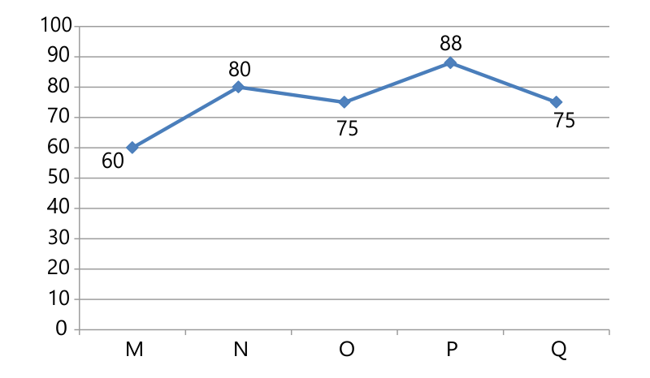
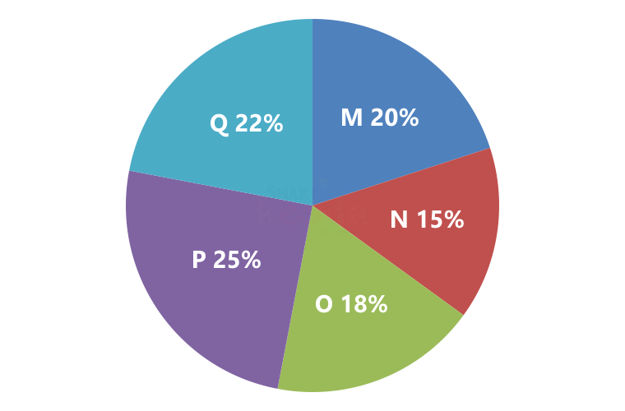
Directions: Study the following information carefully and answer the question given below:
Pie chart shows the production of rice by 5 different factories and line chart shows the percentage of sale.
Total production = 3600 kg
Data Interpretation
What percent of total rice has been sold by all the factory?
A) 55%
B) 66%
C) 76%
D) 50%
Notes:
Difficulty Level: MODERATE (COMPULSORY)
Option: C

Slide 48
Directions: Study the following information carefully and answer the question given below:
Pie chart shows the production of rice by 5 different factories and line chart shows the percentage of sale.
Total production = 3600 kg
Data Interpretation
What is the ratio of rice sold by factory P and Q together to the rice sold by factory N and M together?
A) 71 : 54
B) 77 : 51
C) 77 : 48
D) 69 : 47
Notes:
Difficulty Level: Expert (COMPULSORY)
Option: C

Slide 49
Directions: Study the following information carefully and answer the question given below:
Pie chart shows the production of rice by 5 different factories and line chart shows the percentage of sale.
Total production = 3600 kg
Data Interpretation
If the cost price of rice is Rs 45 per kg and profit earned by factory O on 1 kg rice is 20% of the cost price, find the total profit earned by factory O.
A) Rs 4374
B) Rs 5256
C) Rs 5346
D) Rs 5697
Notes:
Difficulty Level: Expert(COMPULSORY)
Option: A

Slide 50
Directions: Study the following information carefully and answer the question given below:
Pie chart shows the production of rice by 5 different factories and line chart shows the percentage of sale.
Total production = 3600 kg
Data Interpretation
Rice sold by factory M and N together is how much percent more than the production of rice by factory N?
A) 30%
B) 60%
C) 10%
D) 20%
Notes:
Difficulty Level: Expert (COMPULSORY)
Option: B

Slide 51
Directions: Study the following information carefully and answer the question given below:
Pie chart shows the production of rice by 5 different factories and line chart shows the percentage of sale.
Total production = 3600 kg
Data Interpretation
In which of the following factory the sale of rice is the lowest?
A) Factory P
B) Factory Q
C) Factory M
D) Factory O
Notes:
Difficulty Level: (COMPULSORY)
Option: C

Slide 52
Any Doubts???

